Slide 1

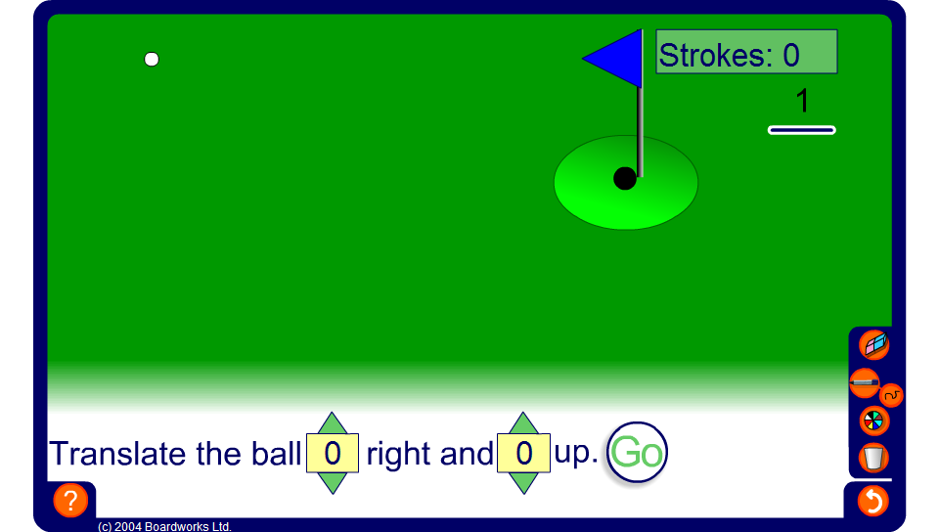


Translation golf
Notes:
In this game pupils are required to estimate the required translation to move the ball to the hole. The length of one unit is shown in the top right-hand corner.
To translate the ball to the left or down, a negative number must be used.
Challenge pupils to get the ball into the hole in as few moves as possible.

